Slide 1
Properties of Blockchain

Slide 2
Properties of Blockchain
Blockchain has properties of both decentralized and distributed networks.
Using those types of networks along with cryptography adds more properties.
We are covering here in this course properties related to the Ethereum blockchain rather than other blockchain implementation properties.
The other blockchain implementations might have different properties.

Slide 3
1-Distributed Ledger
Multiple nodes make up a distributed blockchain network. All nodes share a common ledger, where records of transactions are kept.

Slide 4
2-Fault Tolerance
A blockchain network is decentralized and each node maintains the same record of the ledger.
Even if some nodes in the network are corrupted or go down, it can continue operating
Safely up to a certain limit, as well as processing transactions with running nodes.

Slide 5
3-Attack Resistance
A blockchain network does not have centralized control.
The network's resistance to attacks is maintained by the miners who are putting their processing power (using nodes) into use to guard against malicious attacks.
These miners earn some incentives to keep the network
safe by behaving honestly.
This is done by using the decentralized network and cryptographic techniques.

Slide 6
4-Remove Intermediaries
Blockchain technology removes the dependence on TTP/middle parties/intermediaries.
Using blockchain technology, a transaction can be done directly between two entities/systems. In place of intermediaries, we can place blockchain systems.

Slide 7
5-Consensus Protocol
This is a protocol that ensures that all nodes participating in the network ensure the safety of the network.
All nodes use a consensus protocol (a specific algorithm) to reach a consensus and discard the blocks generated by the attacker/bad node, to avoid catastrophic system failure.
Ethereum uses the Ethash PoW consensus algorithm, which is Application Specific Integrated Circuit (ASIC) resistance.
In the future, Ethereum will switch its consensus algorithm from PoW to Proof-of-Stake (PoS).

Slide 8
6-Faster Settlement
Traditional banking systems can be slow in some cases, as they need additional time for processing a transaction; for example, cross-border payments..
However, with blockchain technology, there are no intermediaries; therefore, the transaction happens directly between entities and the settlement is much faster, compared to traditional systems.

Slide 9
7-Low Transaction Fee
Using the traditional banking system, doing a cross-border payments is costly.
The intermediaries take their commission to process the transaction between two parties.
But by using blockchain technology, the cost of doing transactions is significantly lower because we can remove the intermediaries and perform the transactions directly.

Slide 10
8-Transparency
Some blockchain systems maintain transparency. Ethereum is a public blockchain network.
All the transactions of the Ethereum blockchain are public and transparent. Anyone can see the balance and transaction history of any wallet at any time, just by accessing the Ethereum public blockchain via a block explorer.

Slide 11
9-Immutability
Every transaction that happens on the Ethereum blockchain is immutable. Smart contracts on the Ethereum blockchain are also immutable.
Once the smart contract code is deployed, it cannot be changed. Smart contract code will remain on the blockchain forever.
Anyone can see any deployed smart contract any time in the future as well, just by putting its contract address on the block explorers.
Data that is being stored in smart contract variables is also immutable, unless there are data removal techniques that have not been exposed by the contract code.

Slide 12
10-Irreversible transactions
Once a transaction is executed on a blockchain and it receives sufficient confirmation, the transaction becomes irreversible.
The irreversible transaction ensures the safety of the value transfer.
The higher the number of confirmations received for a transaction, the harder it becomes to reverse the transaction from the attacker.

Slide 13
11-Trustless Systems
Two people, without knowing each other, can do transactions using blockchain technology.
They do not have to trust each other, they only have to trust blockchain technology. For both persons, it is a trustless system.

Slide 14
12-Availability
Centralized systems sometimes have to go through regular maintenance and downtime, resulting in inconvenience to the users.
The blockchain is decentralized, so even if some nodes go down/are corrupted, the network will continue to function and will be available to process transactions 24/7.

Slide 15
13-Empower Individuals
Each individual entity/person has their own wallet's public and private keys on the blockchain network. Using those wallets, they are in full control of their assets and the privileges available for those wallets.
Blockchain assures that the ownership of a person's data is in their hands.
However, an individual can only maintain full control over their cryptocurrency or data when they own the private keys of their wallet. When the private keys of their wallet is maintained by another entity, such as centralized exchanges, they may not have full control.

Slide 16
14-Chronological order of transactions
Blockchains keep their transactions in blocks.
Multiple transactions are coupled together and stored in a new block. Next, that new block is appended to the chain of previous blocks.
This keeps all the blockchain transactions maintained in chronological order.

Slide 17
15-Timestamped
Every transaction on the blockchain is stamped with the current time.
This enables the blockchain to maintain all the transaction histories of an account.
Also, this can be used to prove whether or not a transaction happened on a certain date and at a certain time.

Slide 18
16-Sealed with cryptography
Asymmetric cryptography is used for wallet generation and transaction signing using the Elliptic Curve Digital Signature Algorithm (ECDSA).
All transactions are packed together using the Merkle tree and SHA-256 cryptographic algorithms.
This makes blockchains secure and reliable to use.

Slide 19
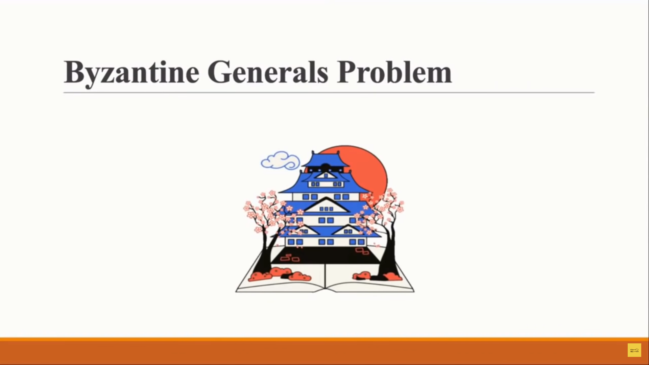

Slide 20
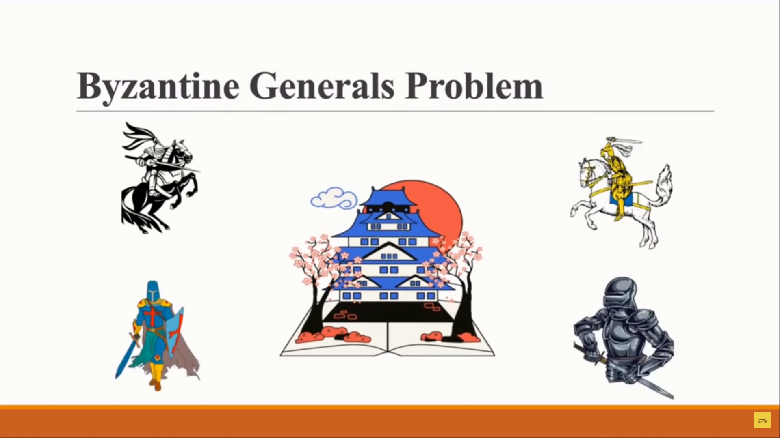

Slide 21
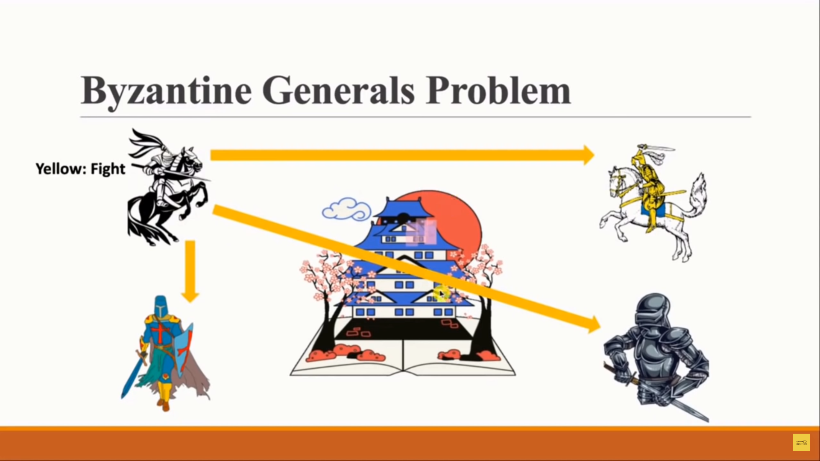

Slide 22
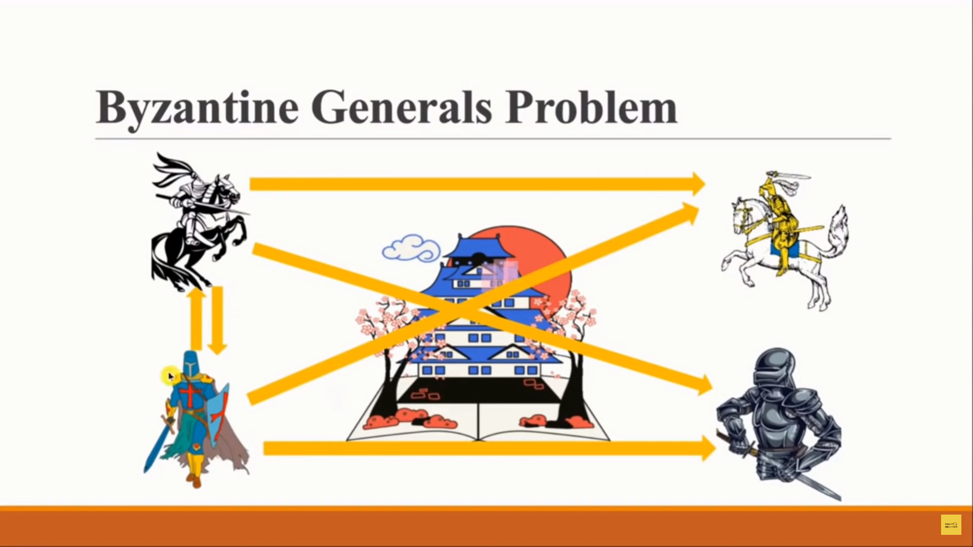

Slide 23
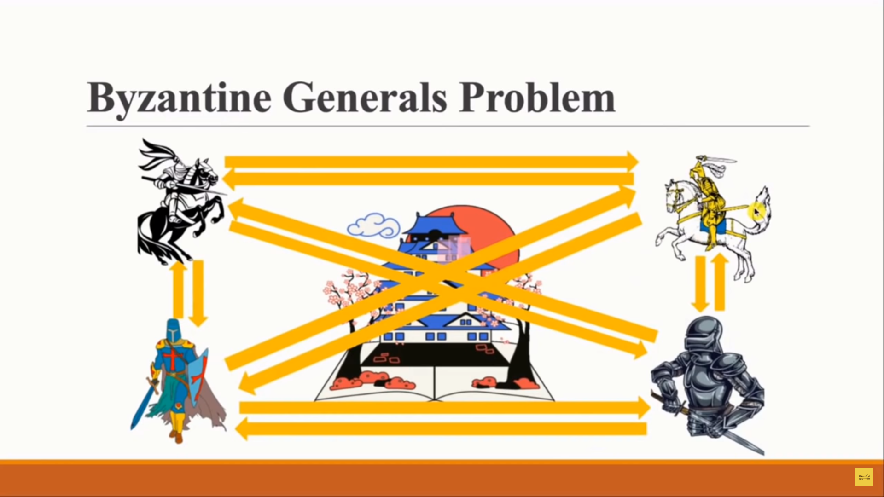

Slide 24
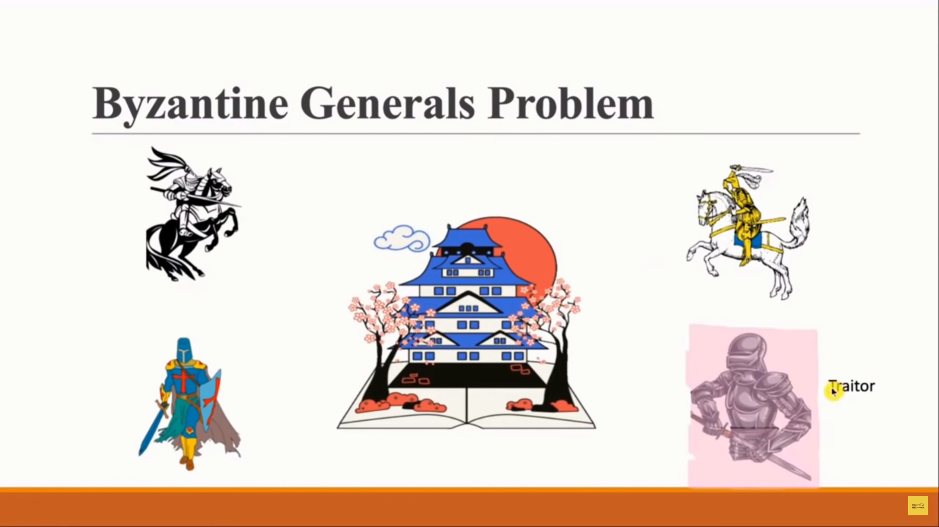

Slide 25
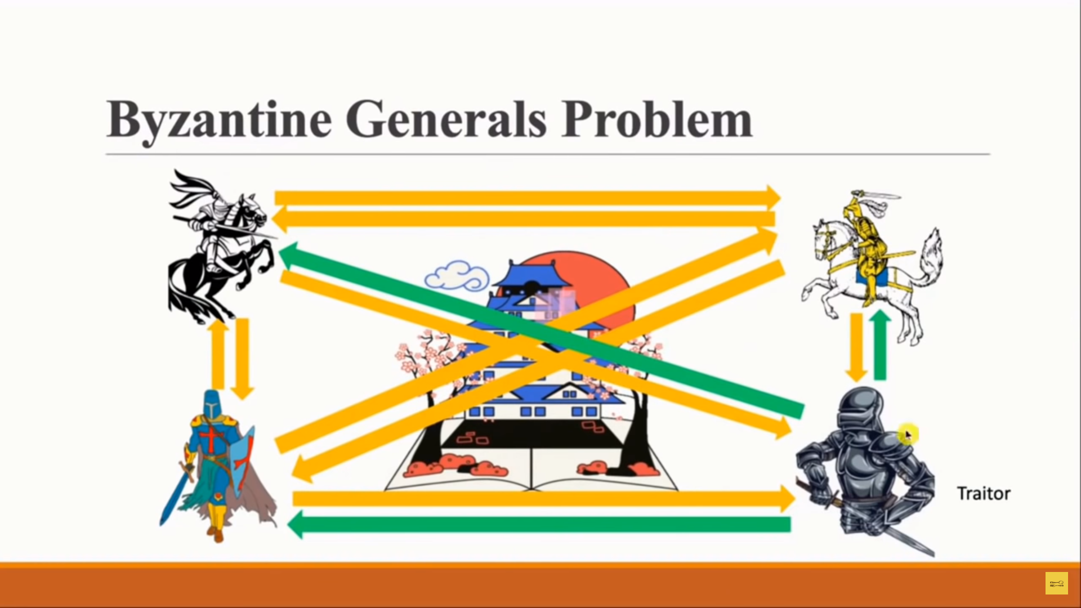

Slide 26
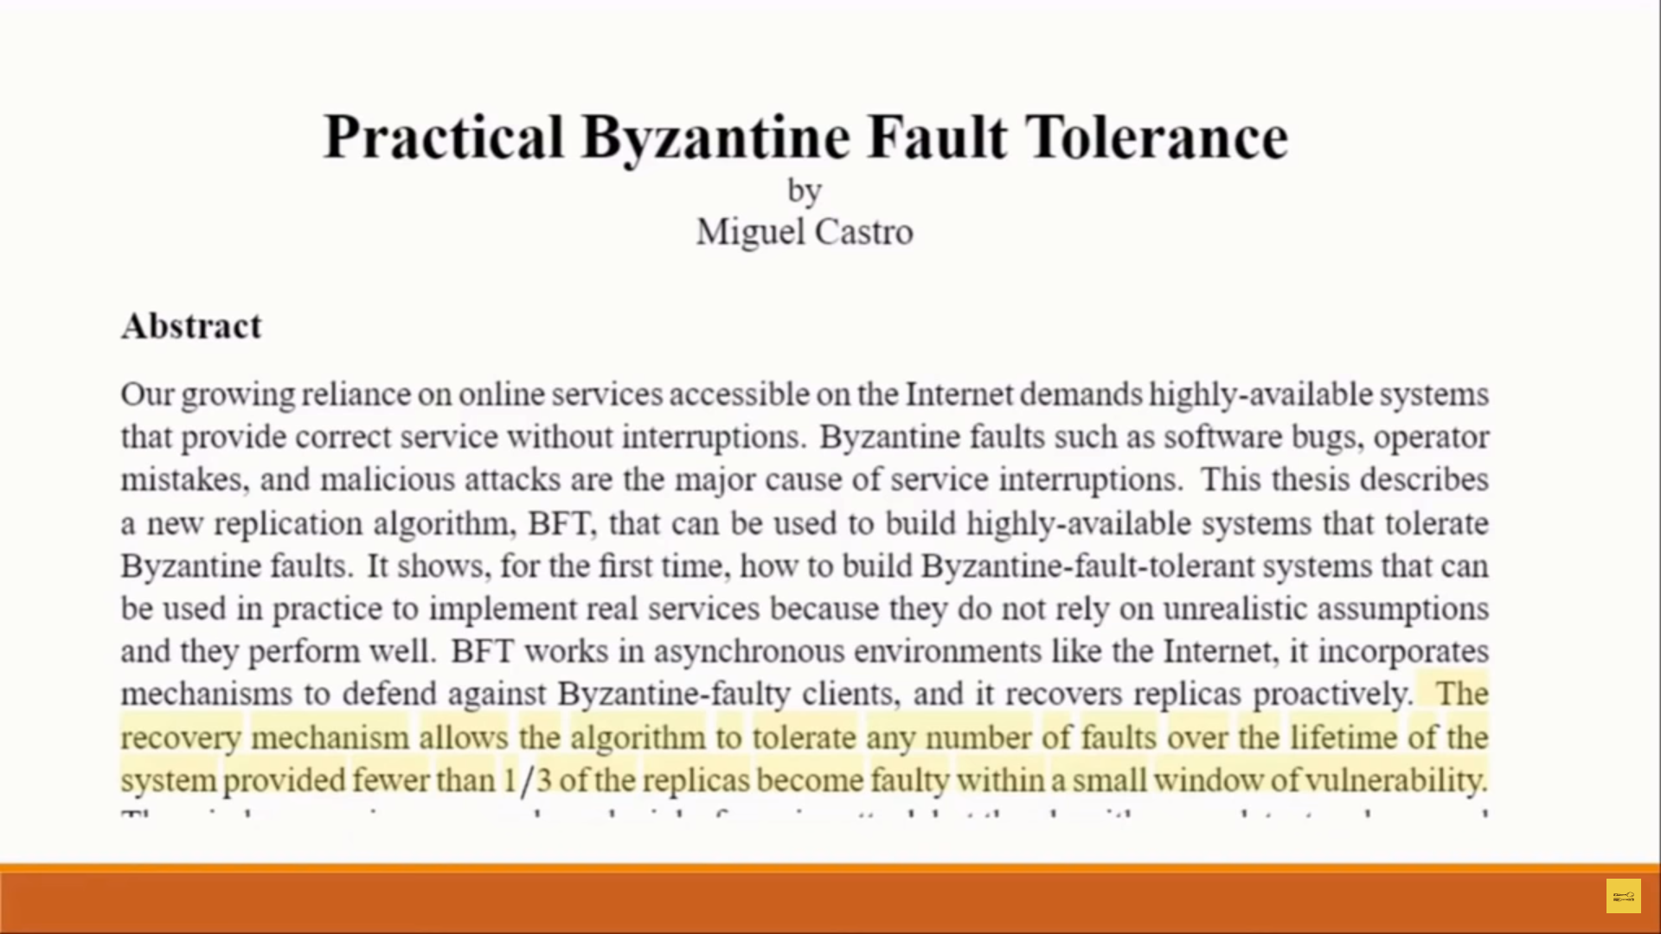

Slide 27
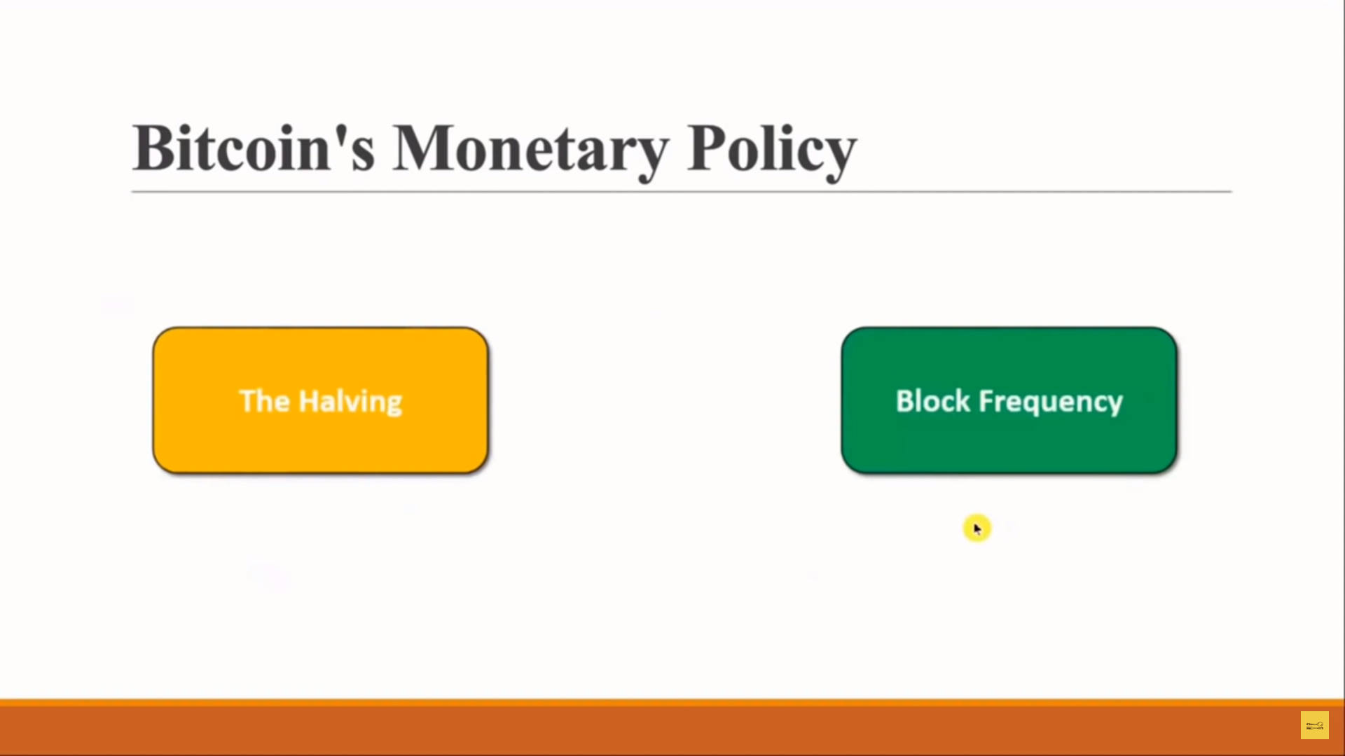

Slide 28
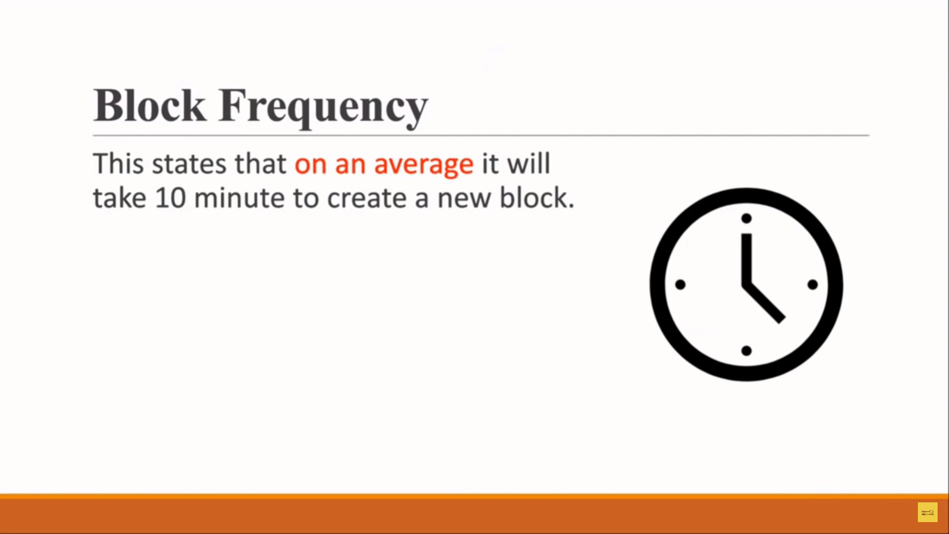

Slide 29
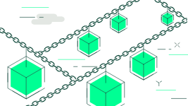
Blocks in Blockchain
Blockchain is a method of securely recording data or information which makes it hard to hack or change the system. A blockchain is simply a virtual record of transactions that is replicated and distributed throughout the blockchain's complete network of computer systems.
Each block on the chain comprises a number of transactions,
and whenever a new transaction happens on the blockchain,
a record of that transaction is added to the ledger of every
participant. A blockchain network consists of millions of blocks.

Slide 30
How does Blocks works
in any cryptocurrency, there are a huge number of transactions occurring every day throughout the world. It is important for the users to keep track of these transactions, and they can do it with the help of blocks. A block contains the recent data and every time the block is completed, it becomes a part of the past and makes room for a new block on the blockchain.
The completed block is a permanent record of prior transactions, and new ones are recorded in the current one. As a result, the entire system enters into a loop that permanently saves all data.

Slide 31
Header: It is used to identify the particular block in the entire blockchain. It handles all blocks in the blockchain. A block header is hashed periodically by miners by changing the nonce value as part of normal mining activity, also Three sets of block metadata are contained in the block header.
Previous Block Address/ Hash: It is used to connect the i+1th block to the ith block using the hash. In short, it is a reference to the hash of the previous (parent) block in the chain.
Timestamp: It is a system verify the data into the block and assigns a time or date of creation for digital documents. The timestamp is a string of characters that uniquely identifies the document or event and indicates when it was created.
Nonce: A nonce number which uses only once. It is a central part of the proof of work in the block. It is compared to the live target if it is smaller or equal to the current target. People who mine, test, and eliminate many Nonce per second until they find that Valuable Nonce is valid.
Merkel Root: It is a type of data structure frame of different blocks of data. A Merkle Tree stores all the transactions in a block by producing a digital fingerprint of the entire transaction. It allows the users to verify whether a transaction can be included in a block or not.

Slide 32
Types of Blocks
There are three type of blocks in blockchain
Genesis Block
Valid Block
Orphan Block

Slide 33
Genesis Block
The genesis block holds a pivotal role as the initial block in a blockchain network. It is manually crafted by the developers, setting the groundwork for the entire system. This first block establishes crucial parameters, such as network settings and token distribution, and does not reference any previous blocks. Subsequent blocks are added to the chain, linking back to the genesis block's cryptographic hash, ensuring the integrity and immutability of the blockchain. In essence, the genesis block serves as the starting point from which the entire blockchain network evolves and grows.

Slide 34
Valid Block
Valid blocks are all such blocks that have been mined and added to the blockchain. To get a valid block, each mined block must get network permission and report as a block that has solved the given cryptographic puzzle.
When the network reaches consensus, the block is added to the blockchain and distributed to all nodes. As a result, every node in the network has a new block and acts as a verification point for it. All the operations and transactions that are happening in any cryptocurrency are allowed by these blocks.

Slide 35
Orphan Block
Orphan blocks are also correctly named as these blocks are not part of the blockchain network. These are generally generated by two miners mixing blocks at almost the same time, but they can also be caused by an attacker with enough computational power with the intention of reversing any transaction.
The network consensus procedure is invoked at this point to determine which blocks will be verified (included in the chain) and which will be orphaned. Usually, the longest blockchain that contains the most amount of transactions and information will generally be decided on. Hence, making the security process very simple.
Link: https://www.analyticssteps.com/blogs/3-types-block-blockchain-network

Slide 36
